Slide 1

Intro to Client Server architecture

Slide 2


Course : Backend
Lecture On : Intro to client server architecture
Instructor :

Slide 3
Today’s Agenda
Client server architecture
Networking basics
Http protocol
Operating system basics

Slide 4
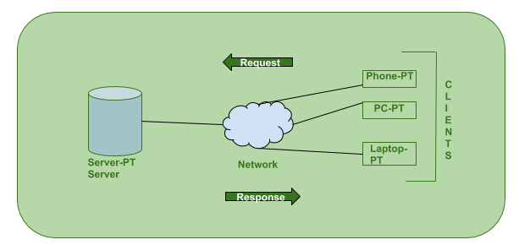
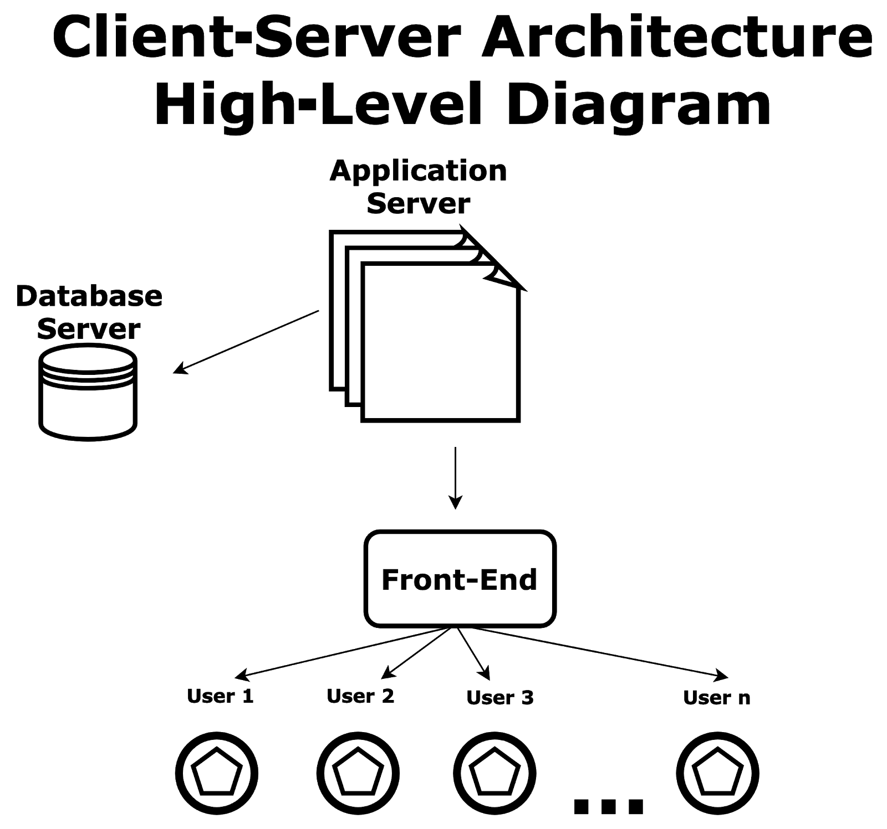
Client server architecture
•Client-server architecture, architecture of a computer network in which many clients (remote processors) request and receive service from a centralized server (host computer).
•the Client requesting something and the Server serving it as long as its present in the database.

Slide 5
Client server architecture
What is client?
When we talk the word Client, it mean to talk of a person or an organization using a particular service. Similarly in the digital world a Client is a computer (Host) i.e. capable of receiving information or using a particular service from the service providers (Servers).
What is server?
The word Servers, It mean a person or medium that serves something. Similarly in this digital world a Server is a remote computer which provides information (data) or access to particular services.

Slide 6
Client server architecture - How the browser interacts with the servers ?
There are few steps to follow to interacts with the servers a client.
User enters the URL(Uniform Resource Locator) of the website or file. The Browser then requests the DNS(DOMAIN NAME SYSTEM) Server.
DNS Server lookup for the address of the WEB Server.
DNS Server responds with the IP address of the WEB Server.
Browser sends over an HTTP/HTTPS request to WEB Server’s IP (provided by DNS server).
Server sends over the necessary files of the website.
Browser then renders the files and the website is displayed. This rendering is done with the help of DOM (Document Object Model) interpreter, CSS interpreter and JS Engine collectively known as the JIT or (Just in Time) Compilers.

Slide 7
Networking basics
Open system:
A system which is connected to the network and is ready for communication.
Closed system:
A system which is not connected to the network and can’t be communicated with.
Computer Network:
An interconnection of multiple devices, also known as hosts, that are connected using multiple paths for the purpose of sending/receiving data or media. Computer networks can also include multiple devices/mediums which help in the communication between two different devices; these are known as and include things such as routers, switches, hubs, and bridges.
Network Topology:
The layout arrangement of the different devices in a network. Common examples include: Bus, Star, Mesh, Ring, and Daisy chain.

Slide 8
Networking basics
OSI:
OSI stands for Open Systems Interconnection. It is a reference model that specifies standards for communications protocols and also the functionalities of each layer.
Protocol:
A protocol is the set of rules or algorithms which define the way how two entities can communicate across the network and there exists different protocol defined at each layer of the OSI model. Few of such protocols are TCP, IP, UDP, ARP, DHCP, FTP and so on.
Host name:
Each device in the network is associated with a unique device name known as Hostname.

Slide 9
Networking basics
IP Address (Internet Protocol address):
Also known as the Logical Address, the IP Address is the network address of the system across the network.
To identify each device in the world-wide-web, the Internet Assigned Numbers Authority (IANA) assigns an IPV4 (Version 4) address as a unique identifier to each device on the Internet.
The length of an IPv4 address is 32-bits, hence, we have 2³² IP addresses available. The length of an IPv6 address is 128-bits.
MAC Address (Media Access Control address):
Also known as physical address, the MAC Address is the unique identifier of each host and is associated with its NIC (Network Interface Card).
A MAC address is assigned to the NIC at the time of manufacturing.
The length of the MAC address is : 12-nibble/ 6 bytes/ 48 bits
Type “ipconfig/all” in the command prompt and press ‘Enter’, this gives us the MAC address.

Slide 10
Networking basics
Port:
A port can be referred to as a logical channel through which data can be sent/received to an application.
Socket:
The unique combination of IP address and Port number together are termed as Socket.
DNS Server:
DNS stands for Domain Name system.
DNS is basically a server which translates web addresses or URLs (ex: www.google.com) into their corresponding IP addresses. We don’t have to remember all the IP addresses of each and every website.

Slide 11
Networking basics
ARP:
ARP stands for Address Resolution Protocol.
It is used to convert an IP address to its corresponding physical address(i.e., MAC Address).
ARP is used by the Data Link Layer to identify the MAC address of the Receiver’s machine.
RARP:
RARP stands for Reverse Address Resolution Protocol.
As the name suggests, it provides the IP address of the device given a physical address as input.
Router:
A router is a networking device that forwards data packets between computer networks. Routers perform the traffic directing functions on the Internet. Data sent through the internet, such as a web page or email, is in the form of data packets.

Slide 12
Networking basics
Hub
A hub is a physical layer networking device which is used to connect multiple devices in a network. They are generally used to connect computers in a LAN.
Bridge
A network bridge is a computer networking device that creates a single aggregate network from multiple communication networks or network segments.
Wireless Router
A wireless router is a device in a wireless local area network (WLAN) that determines the next network point to which a packet should be forwarded toward its destination.
Switch
A network switch is networking hardware that connects devices on a computer network by using packet switching to receive and forward data to the destination device.

Slide 13
Networking basics
Hub
A hub is a physical layer networking device which is used to connect multiple devices in a network. They are generally used to connect computers in a LAN.
Bridge
A network bridge is a computer networking device that creates a single aggregate network from multiple communication networks or network segments.
Wireless Router
A wireless router is a device in a wireless local area network (WLAN) that determines the next network point to which a packet should be forwarded toward its destination.
Switch
A network switch is networking hardware that connects devices on a computer network by using packet switching to receive and forward data to the destination device.

Slide 14
Networking basics
LAN(Local Area Network)
1.Local Area Network is a group of computers connected to each other in a small area such as building, office.
2.LAN is used for connecting two or more personal computers through a communication medium such as twisted pair, coaxial cable, etc.
3.It is less costly as it is built with inexpensive hardware such as hubs, network adapters, and ethernet cables.
4.The data is transferred at an extremely faster rate in Local Area Network.
5.Local Area Network provides higher security.

Slide 15
Networking basics
PAN(Personal Area Network)
1.Personal Area Network is a network arranged within an individual person, typically within a range of 10 meters.
2.Personal Area Network is used for connecting the computer devices of personal use is known as Personal Area Network.
3.Thomas Zimmerman was the first research scientist to bring the idea of the Personal Area Network.
4.Personal Area Network covers an area of 30 feet.
5.Personal computer devices that are used to develop the personal area network are the laptop, mobile phones, media player and play stations.

Slide 16
Networking basics
MAN(Metropolitan Area Network)
1.A metropolitan area network is a network that covers a larger geographic area by interconnecting a different LAN to form a larger network.
2.Government agencies use MAN to connect to the citizens and private industries.
3.In MAN, various LANs are connected to each other through a telephone exchange line.
4.The most widely used protocols in MAN are RS-232, Frame Relay, ATM, ISDN, OC-3, ADSL, etc.
5.It has a higher range than Local Area Network(LAN).

Slide 17
Networking basics
WAN(Wide Area Network)
1.A Wide Area Network is a network that extends over a large geographical area such as states or countries.
2.A Wide Area Network is quite bigger network than the LAN.
3.A Wide Area Network is not limited to a single location, but it spans over a large geographical area through a telephone line, fiber optic cable or satellite links.
4.The internet is one of the biggest WAN in the world.
5.A Wide Area Network is widely used in the field of Business, government, and education.

Slide 18
Networking basics
WAN(Wide Area Network)
1.A Wide Area Network is a network that extends over a large geographical area such as states or countries.
2.A Wide Area Network is quite bigger network than the LAN.
3.A Wide Area Network is not limited to a single location, but it spans over a large geographical area through a telephone line, fiber optic cable or satellite links.
4.The internet is one of the biggest WAN in the world.
5.A Wide Area Network is widely used in the field of Business, government, and education.

Slide 19
Networking basics
Geometric representation of how the computers are connected to each other is known as topology. There are five types of topology – Mesh, Star, Bus, Ring and Hybrid.
In mesh topology each device is connected to every other device on the network through a dedicated point-to-point link. When we say dedicated it means that the link only carries data for the two connected devices only.
In star topology each device in the network is connected to a central device called hub. Unlike Mesh topology, star topology doesn’t allow direct communication between devices, a device must have to communicate through hub. If one device wants to send data to other device, it has to first send the data to hub and then the hub transmit that data to the designated device.
In bus topology there is a main cable and all the devices are connected to this main cable through drop lines. There is a device called tap that connects the drop line to the main cable. Since all the data is transmitted over the main cable, there is a limit of drop lines and the distance a main cable can have.

Slide 20
Networking basics
In ring topology each device is connected with the two devices on either side of it. There are two dedicated point to point links a device has with the devices on the either side of it. This structure forms a ring thus it is known as ring topology. If a device wants to send data to another device then it sends the data in one direction, each device in ring topology has a repeater, if the received data is intended for other device then repeater forwards this data until the intended device receives it.
A combination of two or more topology is known as hybrid topology. For example a combination of star and mesh topology is known as hybrid topology.

Slide 21
HTTP Protocol
•The World Wide Web is about communication between web clients and web servers.
•HTTP stands for Hypertext Transfer Protocol.
•Communication between clients and servers is done by requests and responses.
•This protocol is known as Hypertext Transfer Protocol because of its efficiency that allows us to use in a hypertext environment where there are rapid jumps from one document to another document.
•HTTP is similar to the FTP as it also transfers the files from one host to another host. But, HTTP is simpler than FTP as HTTP uses only one connection, i.e., no control connection to transfer the files.
•HTTP is used to carry the data in the form of MIME-like format.
•HTTP is similar to SMTP as the data is transferred between client and server. The HTTP differs from the SMTP in the way the messages are sent from the client to the server and from server to the client. SMTP messages are stored and forwarded while HTTP messages are delivered immediately.

Slide 22
HTTP Protocol
Features of HTTP:
Connectionless protocol: HTTP is a connectionless protocol. HTTP client initiates a request and waits for a response from the server. When the server receives the request, the server processes the request and sends back the response to the HTTP client after which the client disconnects the connection. The connection between client and server exist only during the current request and response time only.
Media independent: HTTP protocol is a media independent as data can be sent as long as both the client and server know how to handle the data content. It is required for both the client and server to specify the content type in MIME-type header.
Stateless: HTTP is a stateless protocol as both the client and server know each other only during the current request. Due to this nature of the protocol, both the client and server do not retain the information between various requests of the web pages.

Slide 23
Operating system basics
An operating system (OS) is a collection of software that manages computer hardware resources and provides common services for computer programs. The operating system is a vital component of the system software in a computer system.
Some popular Operating Systems include Linux Operating System, Windows Operating System, VMS, OS/400, AIX, z/OS, etc.

Slide 24
Operating system basics
Following are some of important functions of an operating System.
Memory Management
Processor Management
Device Management
File Management
Security
Control over system performance
Job accounting
Error detecting aids
Coordination between other software and users

Slide 25
#LifeKoKaroLift
Thank You!

